Slide 1
Bio& 241 Unit 1 / Lecture 4

Slide 2
Connective Tissue
Consists of two basic elements:
Cells
and
Extra-cellular matrix

Slide 3
True Connective Tissue Cells
Fibroblasts: Secrete both fibers and ground substance of the matrix (wandering)
Macrophages: Phagocytes that develop from Monocytes (wandering or fixed)
Plasma Cells: Antibody secreting cells that develop from B Lymphocytes (wandering)
Mast Cells: Produce histamine that help dilate small blood vessels in reaction to injury (wandering)
Adipocytes: Fat cells that store triglycerides, support, protect and insulate (fixed)

Slide 4
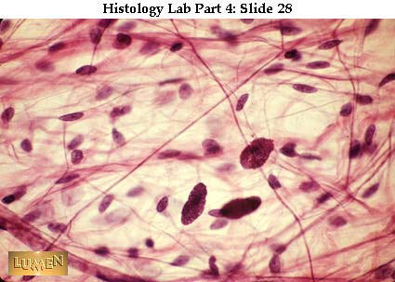
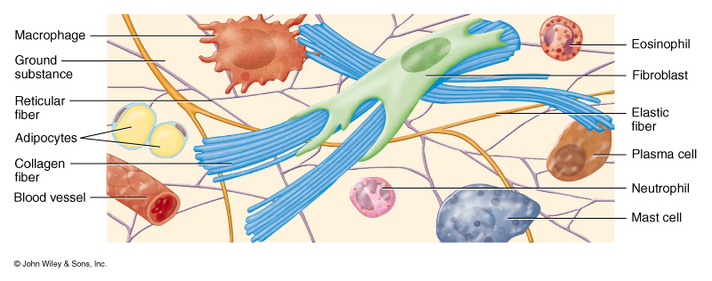

Slide 5
Matrix Fibers
Collagen Fibers: Large fibers made of the protein collagen and are typically the most abundant fibers. Promote tissue flexibility.
Elastic Fibers: Intermediate fibers made of the protein elastin. Branching fibers that allow for stretch and recoil
Reticular Fibers: Small delicate, branched fibers that have same chemical composition of collagen. Forms structural framework for organs such as spleen and lymph nodes.

Slide 6
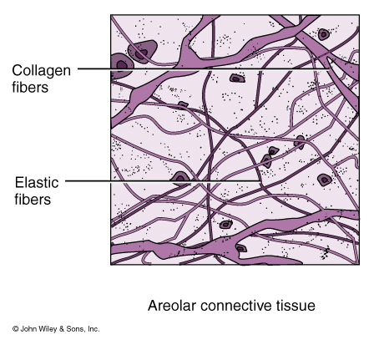

Slide 7
Matrix Ground Substance
Hyaluronic Acid: Complex combination of polysaccharides and proteins found in “true” or proper connective tissue.
Chondroitin sulfate: Jellylike ground substance of cartilage, bone, skin and blood vessels.
Other ground Substances:
Dermatin sulfate, keratin sulfate, and adhesion proteins

Slide 8
TYPES OF CONNECTIVE TISSUE
1. True Connective Tissue a. Loose Connective Tissue
b. Dense Connective Tissue
2. Supportive Connective Tissue a. Cartilage
b. Bone
5. Liquid Connective Tissue
a. Blood

Slide 9
True or Proper Connective Tissue
Loose Connective Tissue:
a. Areolar tissue
Widely distributed under epithelia
b. Adipose tissue
Hypodermis, within abdomen, breasts
c. Reticular connective tissue
Lymphoid organs such as lymph nodes

Slide 10
LOOSE Connective Tissue:
1. Areolar CT
consists of all 3 types of fibers, several types of cells, and semi-fluid ground substance
found in subcutaneous layer and mucous membranes, and around blood vessels, nerves and organs
function = strength, support and elasticity

Slide 11
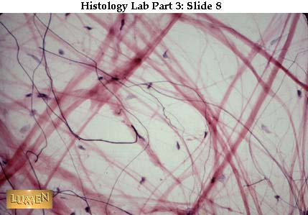

Slide 12
LOOSE Connective Tissue:
2. Adipose tissue
consists of adipocytes; "signet ring" appearing fat cells. They store energy in the form of triglycerides (lipids).
found in subcutaneous layer, around organs and in the yellow marrow of long bones
function = supports, protects and insulates, and serves as an energy reserve

Slide 13
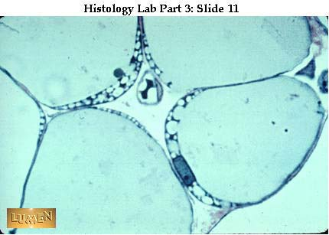

Slide 14
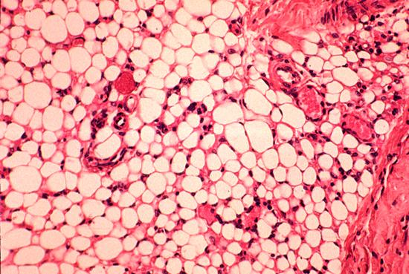
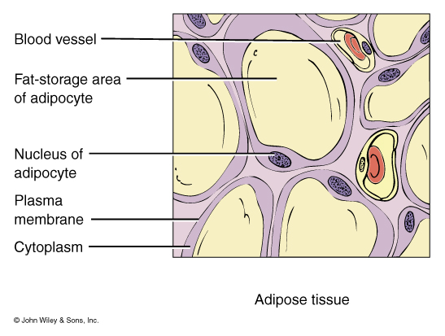

Slide 15
LOOSE Connective Tissue:
3. Reticular CT
Consists of fine interlacing reticular fibers and reticular cells
Found in liver, spleen and lymph nodes
Function = forms the framework (stroma) of organs and binds together smooth muscle tissue cells

Slide 16
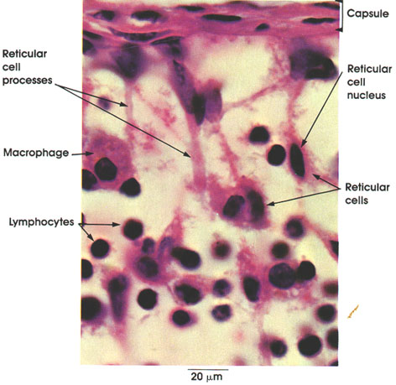

Slide 17
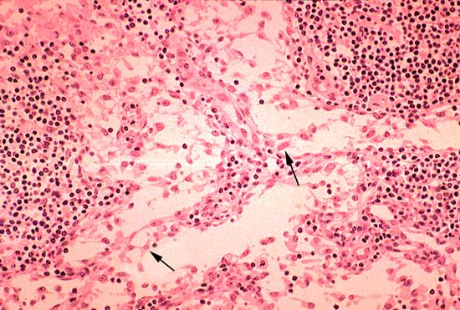

Slide 18
True or Proper Connective Tissue
Dense Connective Tissue:
a. Dense regular connective tissue
Tendons and ligaments
b. Dense irregular connective tissue
Dermis of skin, submucosa of digestive tract

Slide 19
Dense Connective Tissue:
contains more numerous and thicker fibers and far fewer cells than loose CT 1. dense regular Connective Tissue
consists of bundles of collagen fibers and fibroblasts
forms tendons, ligaments and aponeuroses
Function = provide strong attachment between various structures

Slide 20
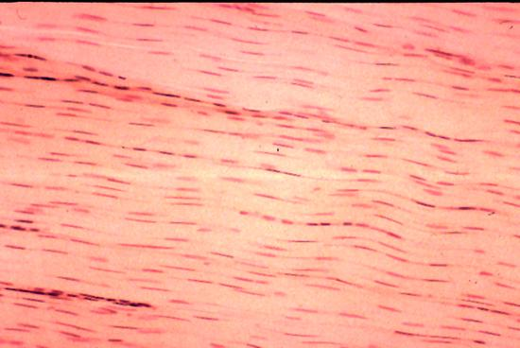
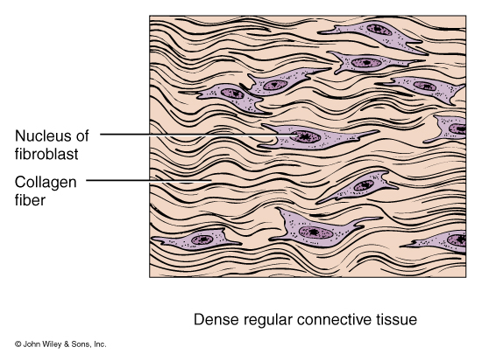

Slide 21
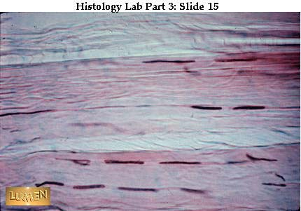

Slide 22
Dense Connective Tissue:
2. Dense Irregular CT
consists of randomly-arranged collagen fibers and a few fibroblasts
Found in fasciae, dermis of skin, joint capsules, and heart valves
Function = provide strength

Slide 23
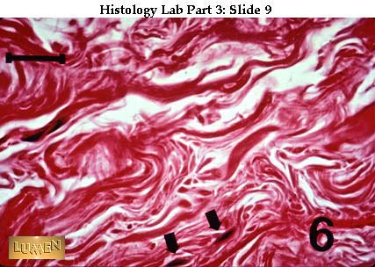
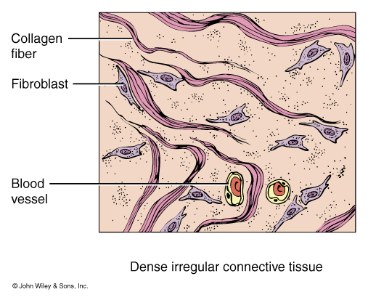

Slide 24
Supportive Connective Tissue:
CARTILAGE:
Jelly-like matrix (chondroitin sulfate) containing collagen and elastic fibers and chondrocytes surrounded by a membrane called the perichondrium.
Unlike other CT, cartilage has NO blood vessels or nerves except in the perichondrium.
The strength of cartilage is due to collagen fibers and the resilience is due to the presence of chondroitin sulfate.
Chondrocytes occur within spaces in the matrix called lacunae.

Slide 25
Supportive Connective Tissue
Hyaline cartilage
Fibrocartilage
Elastic cartilage

Slide 26
Supportive Connective Tissue:
Hyaline Cartilage (most abundant type)
fine collagen fibers embedded in a gel-type matrix. Occasional chondrocytes inside lacunae.
Found in embryonic skeleton, at the ends of long bones, in the nose and in respiratory structures.
Function= flexible, provides support, allows movement at joints

Slide 27
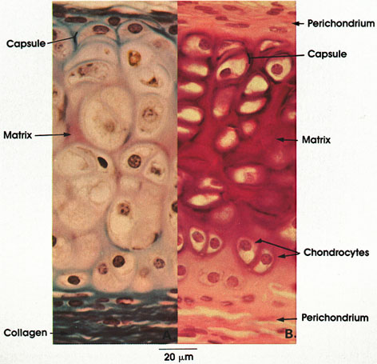

Slide 28
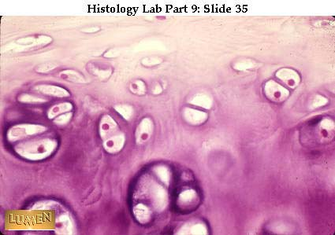
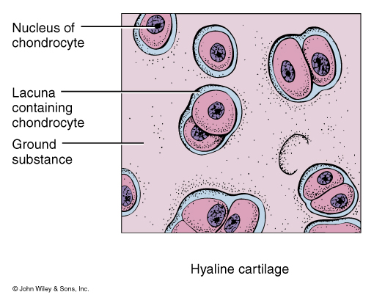

Slide 29
Supportive Connective Tissue:
Fibrocartilage
contains bundles of collagen in the matrix that are usually more visible under microscopy.
Found in the pubic symphysis, intervertebral discs, and menisci of the knee.
Function = support and fusion, and absorbs shocks.

Slide 30
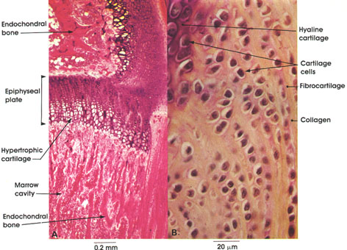

Slide 31
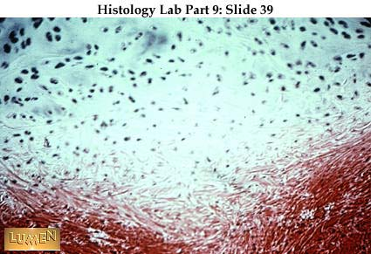
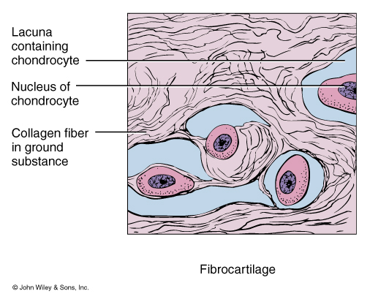

Slide 32
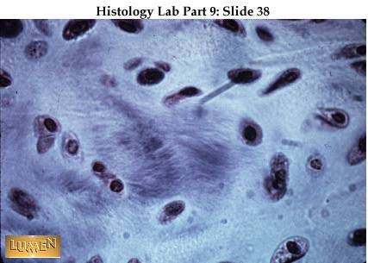

Slide 33
Supportive Connective Tissue:
3. Elastic Cartilage
threadlike network of elastic fibers within the matrix.
found in external ear, auditory tubes, epiglottis.
function = gives support, maintains shape, allows flexibility

Slide 34
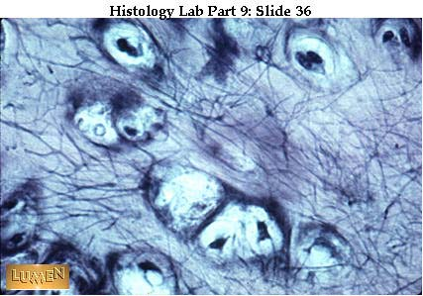
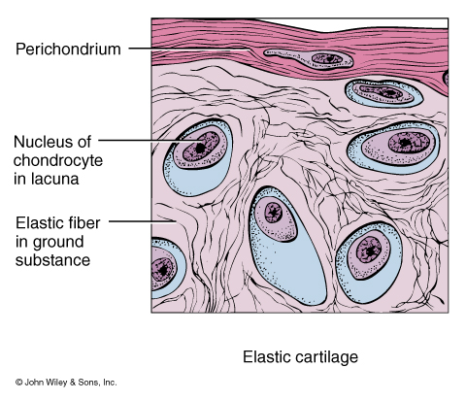

Slide 35
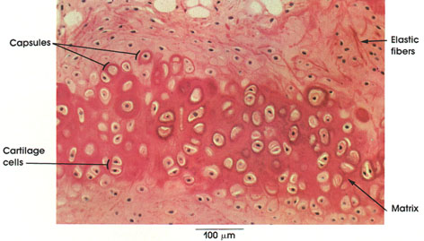

Slide 36
BODY MEMBRANES
Epithelial Membranes = epithelial layer of cells plus the underlying connective tissue.
Three Types: 1. Mucous membranes
2. Serous membranes
3. Cutaneous membranes

Slide 37
BODY MEMBRANES
Mucous membrane = mucosa; it lines cavities that open to the exterior, such as the GI tract.
The epithelial layer of the mucous membrane acts as a barrier to disease organisms.
The connective tissue layer of the mucous membrane is called the lamina propria.
Found as the lining of the mouth, vagina, and nasal passage.

Slide 38
BODY MEMBRANES
Serous membrane = serosa, membrane lines a body cavity that does NOT open to the exterior and it covers the organs that lie within the cavity. a. pleura = lungs b. pericardium = heart c. peritoneum = abdomen
The serous membrane has two portions: 1. parietal portion = lining outside the cavity. 2. visceral portion = covers the organ.

Slide 39
BODY MEMBRANES
Serous membranes epithelial layer secretes a lubricating SEROUS FLUID, that reduces friction between organs and the walls of the cavities in which they are located.
The serous fluid is named by location:
Pleural fluid is found between the parietal and visceral pleura of the lungs.
Pericardial fluid is found between the parietal and visceral pericardium of the heart.
Peritoneal fluid is found between the parietal and visceral peritoneum of the abdomen.

Slide 40
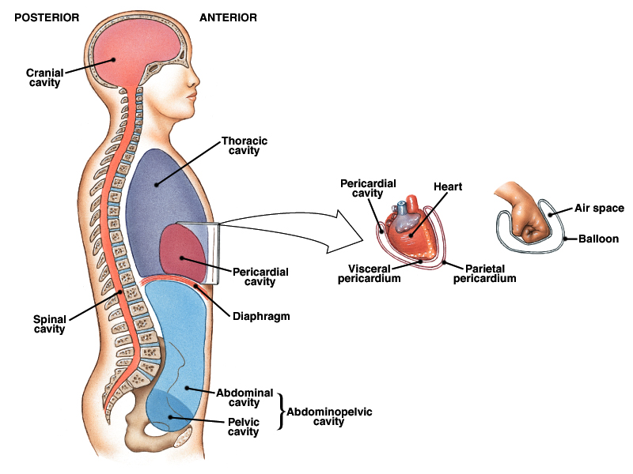
BODY MEMBRANES

Slide 41
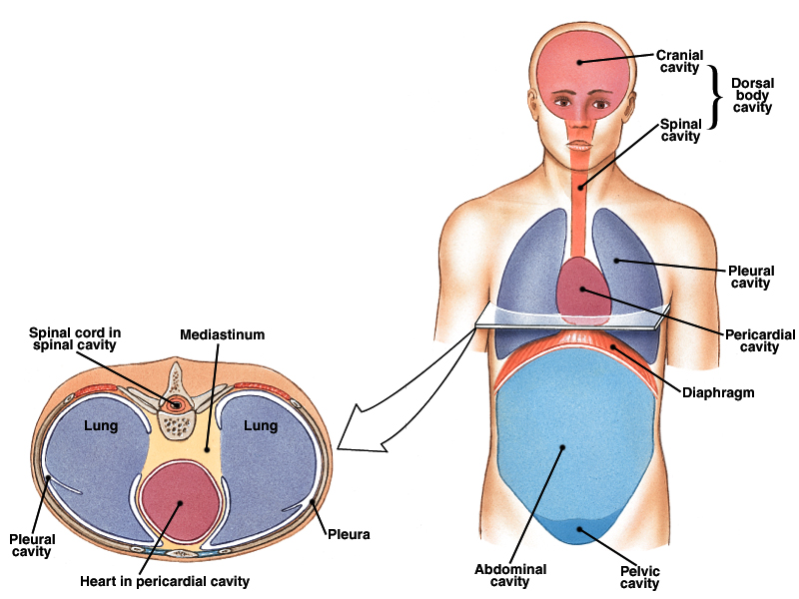
BODY MEMBRANES

Slide 42
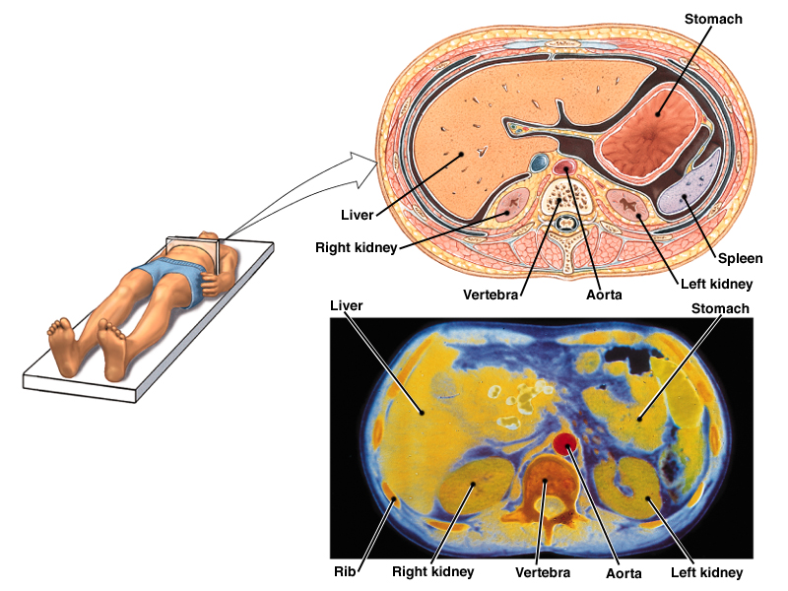
BODY MEMBRANES

